Slide 1
Q-Learning (Again!)
Scott O’Hara
Metrowest Developers Machine Learning Group
11/28/2018

Slide 2
References
University of California, Berkeley CS188:
CS188 – Introduction to Artificial Intelligence, Profs. Dan Klein, Pieter Abbeel, et al. http://ai.berkeley.edu/home.html
David Silver, DeepMind:
Introduction to Reinforcement Learning http://www0.cs.ucl.ac.uk/staff/d.silver/web/Teaching.html
CS181 course at Harvard University:
CS181 Intelligent Machines: Perception, Learning and Uncertainty, Sarah Finney, Spring 2009
CS181 Intelligent Machines: Perception, Learning and Uncertainty, Prof. David C Brooks, Spring 2011
CS181 – Machine Learning, Prof. Ryan P. Adams, Spring 2014. https://github.com/wihl/cs181-spring2014
CS181 – Machine Learning, Prof. David Parkes, Spring 2017. https://harvard-ml-courses.github.io/cs181-web-2017/
The material for this talk is primarily drawn from the slides, notes and lectures of these courses:

Slide 3
Q-Learning: Talk outline
Reinforcement Learning
Model-based vs. Model-free RL
Model-based RL
Model-free RL: Q-Learning
Q-Learning Demos
Approximate Q-Learning

Slide 4
Reinforcement Learning

Slide 5
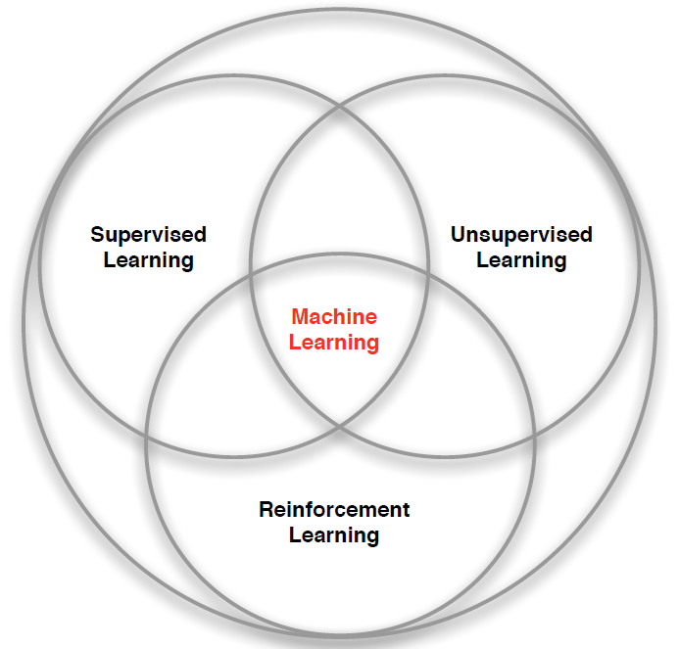
branches of Machine Learning
Credit: adapted from lecture slides David Silver, DeepMind, “Introduction to Reinforcement Learning

Slide 6
Characteristics of Reinforcement Learning
There is no supervisor, only a reward signal
Feedback is delayed, not instantaneous
Time really matters (sequential, data is not i.i.d. – independent and identically distributed.)
Agent’s actions affect the subsequent data it receives.
Credit: adapted from lecture slides David Silver, DeepMind, “Introduction to Reinforcement Learning

Slide 7
Examples of Reinforcement Learning
Fly stunt maneuvers in a helicopter
Defeat the world champion at Backgammon
Manage an investment portfolio
Control a power station
Make a humanoid robot walk
Play Atari games better than humans
Credit: adapted from lecture slides David Silver, DeepMind, “Introduction to Reinforcement Learning

Slide 8
Examples of Reinforcement Learning
RL Course by David Silver – Lecture1: Introduction to Reinforcement Learning
https://www.youtube.com/watch?v=2pWv7GOvuf0
12:25 – 22.00
Credit: adapted from lecture slides David Silver, DeepMind, “Introduction to Reinforcement Learning

Slide 9
Reinforcement Learning: the basic idea
Select an action.
If action leads to reward, reinforce that action.
If action leads to punishment, avoid that action.
Basically, a computational form of Behaviorism (Pavlov, B. F. Skinner).

Slide 10
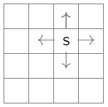
the Learning framework
Learning is performed online, learn as we interact with the world
In contrast with supervised learning, there are no training or test sets. The reward is accumulated over interactions with the environment.
Data is not fixed, more information is acquired as you go.
The training distribution can be influenced by action decisions.

Slide 11
Model-based VS. Model-Free reinforcement learning

Slide 12

RL Model $≅$ (PO)MDP
“Reinforcement learning model” usually implies a Markov Decision Process (MDP) or a Partially-Observable MDP (POMDP).
The Markov Decision Process provides a mathematical framework for reinforcement learning.
MDP is used to model decision making in situations where outcomes are partly random and partly under the control of a decision maker.

Slide 13
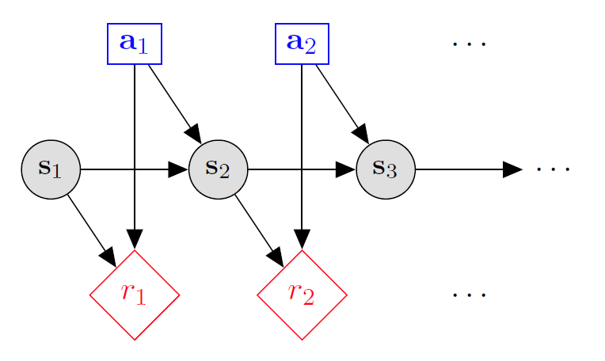

Markov decision processes
States: $s_{1},…,s_{n}$
Actions: $a_{1},…,a_{m}$
Reward Function:
$r\left(s,a,s′\right)∈R$
Transition model:
T(s,a,s’)= $P\left(s′ | s, a\right)$
Discount factor: $γ∈\left[0,1\right]$
<https://en.wikipedia.org/w/index.php?title=Markov_decision_process&oldid=855934986> [accessed 11 September 2018]

Slide 14
Markov decision processes
The initial analysis of MDPs assumes complete knowledge of states, actions, rewards, transitions, and discounts.
When MDPs are applied to reinforcement learning, it is assumed that the transition model and the rewards model are unknown.
<https://en.wikipedia.org/w/index.php?title=Markov_decision_process&oldid=855934986> [accessed 11 September 2018]

Slide 15
Model-Based vs. Model-Free
Model-Based RL
- Agent learns the transition and reward models for the environment a’la MDP.
- Agent can predict:
* how likely it is that it will transition from one state to another given the action it takes.
* the likely reward it will get for taking an action
in a given state.
Model-Free RL
Agent directly learns a policy that optimizes its reward.
Agent CANNOT make predictions about transitions.

Slide 16
Model-Based RL pros and Cons
Pros:
Makes maximal use of experience.
Solves model optimally, given enough experience.
Cons:
Requires computationally expensive solution procedure.
Requires the model to be small enough to solve

Slide 17
Model-Free RL pros and Cons
Pros:
Solution procedure is relatively more efficient.
Can handle much larger models.
Cons:
Learns more slowly. Does not learn as much model-based RL in a single training episode. (“Leaves information on the table”).
Unable to make predictions about transitions in the environment.

Slide 18
Model-free reinforcement learning: Q-Learning

Slide 19

Q-Learning
Don’t learn a model, learn the Q function directly.
(But actually, this is a just a different kind of model.)
Appropriate when model is too large to store, solve or learn
Model-based/Value Iteration transition cost: $O\left(\left|S^{2}\right|\right)$
Model-based/Value Iteration cost: $O\left(\left|A\right|\left|S^{2}\right|\right)$
Model-free / Q-Learning: size of Q function $O\left(\left|A\right|\left|S\right|\right)$

Slide 20
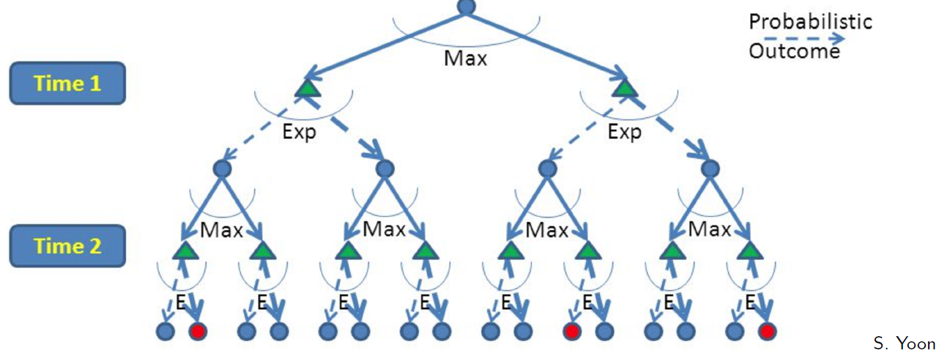
RL is like A game against Nature
Reinforcement learning is like a game-playing algorithm.
Nodes where you move are called states: S ( )
Nodes where nature moves are called Q-states: <S,A> ( )
Credit: CS188 – Intro to AI, UC Berkeley, ai.berkely.edu

Slide 21
Optimal Quantities
The value (utility) of a state s:
V*(s) = expected utility starting in s and acting optimally
The value (utility) of a q-state (s,a):
Q*(s,a) = expected utility starting out having taken action a from state s and (thereafter) acting optimally
The optimal policy:
π*(s) = optimal action from state s
s
s is a state
a
(s, a) is a q-state
s, a
s,a,s’
(s,a,s’) is a transition
s’
Credit: CS188 – Intro to AI, UC Berkeley, ai.berkely.edu
Notes:
Demo just shows V and Q values, snapshots on next slides.

Slide 22



Recall The Bellman Equations
There is one equation $V^{∗}(s)$ for each state s.
There is one equation $Q^{∗}(s,a)$ for each state s and action a.
These are equations, not assignments. They define a relationship, which when satisfied guarantees that $V^{∗}(s)$ and $Q^{∗}\left(s,a\right)$ are optimal for each state and action.
This in turn guarantees that the policy $π^{∗}$is optimal.
s
a
s, a
s,a,s’
s’
Credit: CS188 – Intro to AI, UC Berkeley, ai.berkely.edu
Credit: CS181 – Machine Learning, D. Parkes, Harvard Univ, Spring 2017
Notes:
Let’s start by equations that characterize these quantities through mutual recursions. [step through this by writing on slide, one step at a time]
Recursive characterization of V* in terms of V*; not necessarily helpful; but it is a characterization.
Note: this is a set of equations that needs to be satisfied; but it could have multiple solutions (it does not, but at this stage of our knowledge it could).

Slide 23
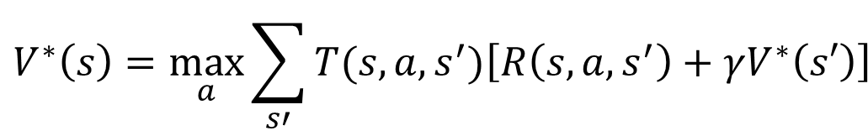
The optimal Value utility Equation V*
V* is rewritten as a recurrence relationship by substituting equation [2] into equation [1]
[1]
[2]
s
a
s, a
$$V^{∗}\left(s\right)=\max_{a}\sum_{s′}{T(s,a,s^{′})\left[R\left(s,a,s^{′}\right)+γV^{∗}\left(s′\right)\right]}$$
s,a,s’
s’
Credit: CS188 – Intro to AI, UC Berkeley, ai.berkely.edu
Credit: CS181 – Machine Learning, D. Parkes, Harvard Univ, Spring 2017
Notes:
Let’s start by equations that characterize these quantities through mutual recursions. [step through this by writing on slide, one step at a time]
Recursive characterization of V* in terms of V*; not necessarily helpful; but it is a characterization.
Note: this is a set of equations that needs to be satisfied; but it could have multiple solutions (it does not, but at this stage of our knowledge it could).

Slide 24
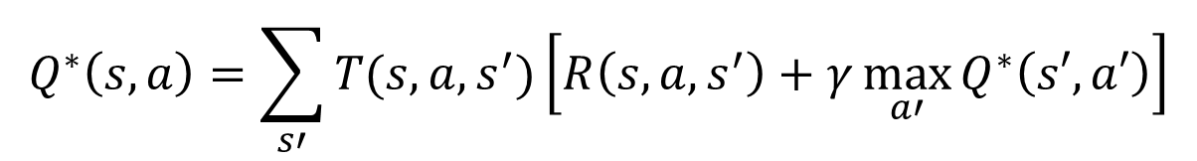
The optimal Value utility Equation Q*
Q* is rewritten as a recurrence relationship by substituting equation [1] into equation [2]
[1]
[2]
s
a
s, a
s,a,s’
$$Q^{∗}\left(s,a\right)=\sum_{s′}{T(s,a,s^{′})\left[R\left(s,a,s^{′}\right)+γ\max_{a′}{Q^{∗}\left(s′,a′\right)}\right]}$$
s’
Credit: CS188 – Intro to AI, UC Berkeley, ai.berkely.edu
Credit: CS181 – Machine Learning, D. Parkes, Harvard Univ, Spring 2017
Notes:
Let’s start by equations that characterize these quantities through mutual recursions. [step through this by writing on slide, one step at a time]
Recursive characterization of V* in terms of V*; not necessarily helpful; but it is a characterization.
Note: this is a set of equations that needs to be satisfied; but it could have multiple solutions (it does not, but at this stage of our knowledge it could).

Slide 25
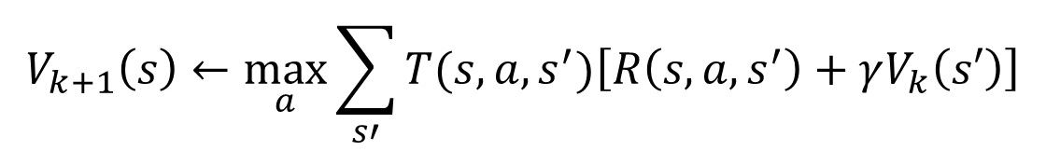
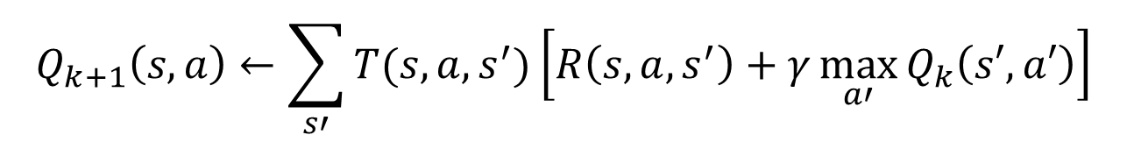
From Value Iteration to Q-Value Iteration
Value iteration: find successive (depth-limited) values
Start with V₀(s) = 0, which we know is right
Given V_{k}, calculate the depth k+1 values for all states:
But Q-values are more useful, so compute them instead
Start with Q₀(s,a) = 0, which we know is right
Given Q_{k}, calculate the depth k+1 q-values for all q-states:
$$V_{k+1}\left(s\right)←\max_{a}\sum_{s′}{T(s,a,s^{′})\left[R\left(s,a,s^{′}\right)+γV_{k}\left(s′\right)\right]}$$
$$Q_{k+1}\left(s,a\right)←\sum_{s′}{T(s,a,s^{′})\left[R\left(s,a,s^{′}\right)+γ\max_{a′}{Q_{k}\left(s′,a′\right)}\right]}$$

Slide 26
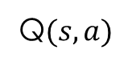
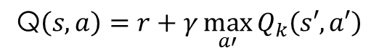
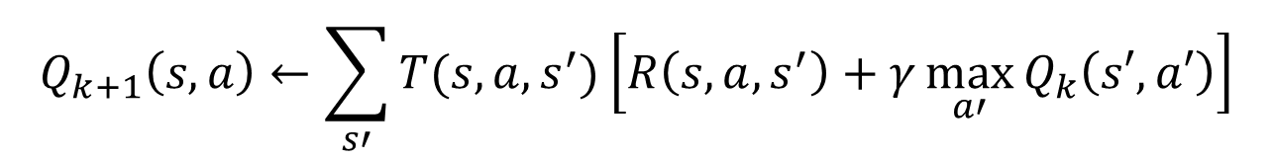
Q-Learning
What to do about T(s,a,s’) and R(s,a,s’), since we don’t have these functions?
Use sample-based Q-value iterantion
Learn Q(s,a) values as you go
Receive a sample transition (s,a,r,s’)
Consider your old estimate:
Consider your new sample estimate:
Incorporate the new estimate into a running average:
$$Q_{k+1}\left(s,a\right)←\sum_{s′}{T(s,a,s^{′})\left[R\left(s,a,s^{′}\right)+γ\max_{a′}{Q_{k}\left(s′,a′\right)}\right]}$$
Q$(s,a)$
$$\text{Q}\left(s,a\right)=r+γ\max_{a′}{Q_{k}\left(s′,a′\right)}$$
$$Q\left(s,a\right)←\left(1−α\right)Q\left(s,a\right)+α\left[r+γ\max_{a′}{Q_{k}\left(s′,a′\right)}\right]$$

Slide 27

Q-Learning update rule
On transitioning from state s to state s’ on action a, and receiving reward r, update:
$α$ is the learning rate
a large $α$ results in quicker learning but may not converge.
$α$ is often decreased as learning goes on.
$γ$ is the discount rate i.e., discounts future rewards
$$Q\left(s,a\right)←\left(1−α\right)Q\left(s,a\right)+α\left[r+γ\max_{a′}{Q_{k}\left(s′,a′\right)}\right]$$

Slide 28
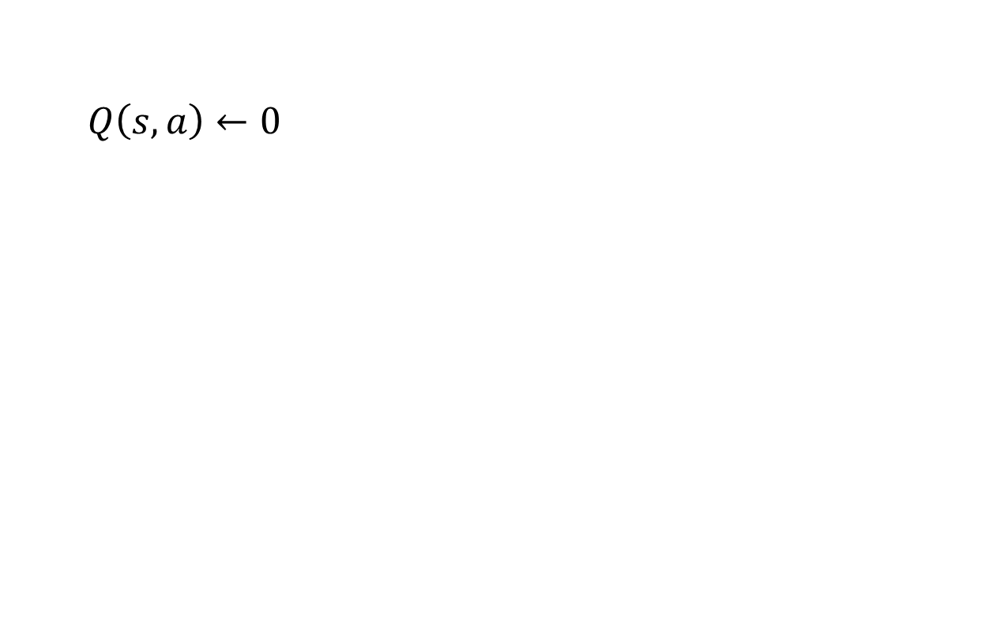
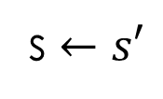
Q-Learning algorithm
For each state s and action a:
$Q\left(s,a\right)←0$
Begin in state s:
Repeat:
For all actions associated with state s, → CHOOSE ACTION a ← based on the Q values for state s
Receive reward r and transition to s’
$$Q\left(s,a\right)←\left(1−α\right)Q\left(s,a\right)+α\left[r+γ\max_{a′}{Q_{k}\left(s′,a′\right)}\right]$$
s $←s′$

Slide 29
Choosing the Action
Learned Q function determines the policy
in state s, choose action with largest Q(s,a)
Still must worry about exploration vs. exploitation.

Slide 30
choosing an action: exploration vs exploitation
Exploit: use your current model to maximize the expected utility now.
Explore: choose an action that will help you improve your model.
How to Exploit? use the current policy.
How to Explore?
choose an action randomly
choose an action you haven’t chosen yet
choose an action that will take you to an unexplored state.

Slide 31


exploration strategy: $ε$-greedy
Explore with probability $ε.$ Exploit with probability $1−ε.$
Weaknesses:
Does not exploit when learning has converged.
Uses:
appropriate if the world is changing.

Slide 32

exploration strategy: Boltzmann
In state s, choose action a with probability p:
$$p=\frac{e^{\frac{Q(s,a)}{t}}}{\sum_{a′}{e^{\frac{Q(s,a′)}{t}}}}$$
Simulated annealing: t is a “temperature”
High temperature means more exploration
Over time, t cools, reducing exploration
Sensitive to cooling schedule.

Slide 33
Q-learning Demos

Slide 34
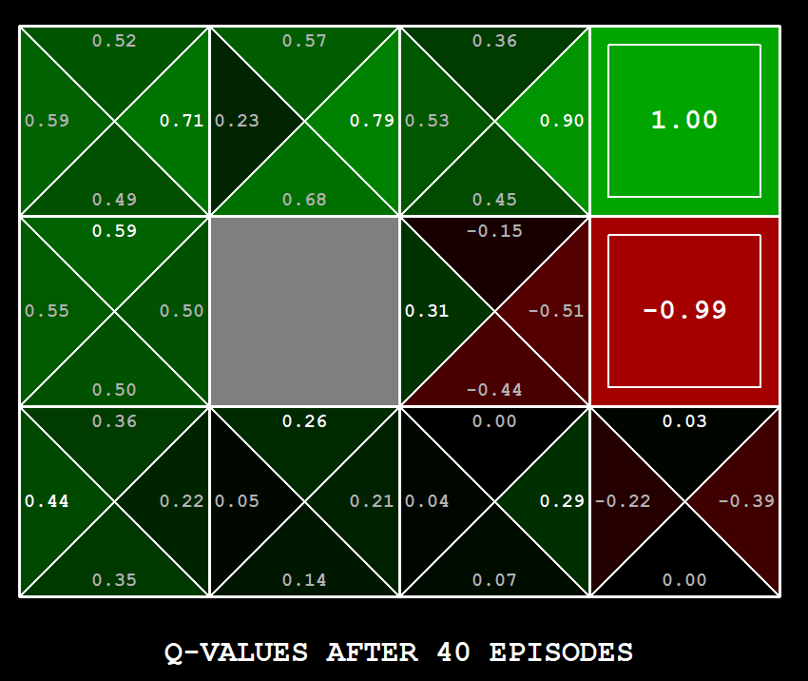
Q-Learning Example: gridworld
Notes:
python gridworld.py -k 40 -w 200 -s 2.0 -a q –v [-p]

Slide 35
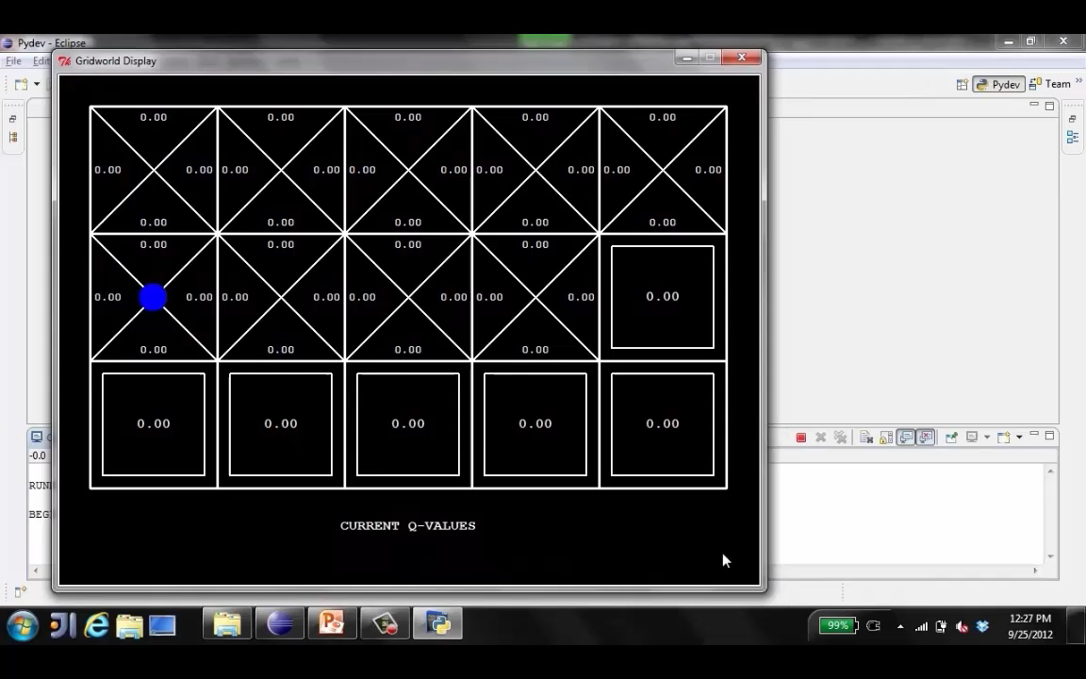
Video of Q-Learning demo -- Gridworld

Slide 36
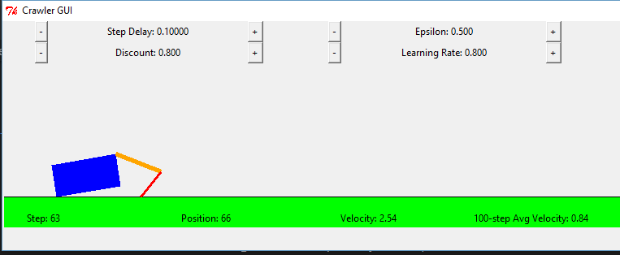
Q-Learning Example: Crawler Robot
Credit: CS188 – Intro to AI, UC Berkeley, ai.berkely.edu

Slide 37
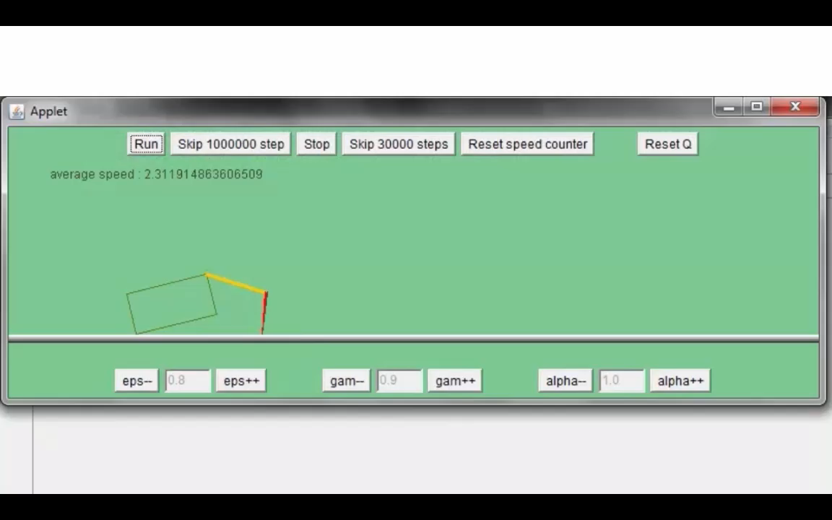
Video 1 of Q-Learning demo -- Crawler
Credit: CS188 – Intro to AI, UC Berkeley, ai.berkely.edu

Slide 38
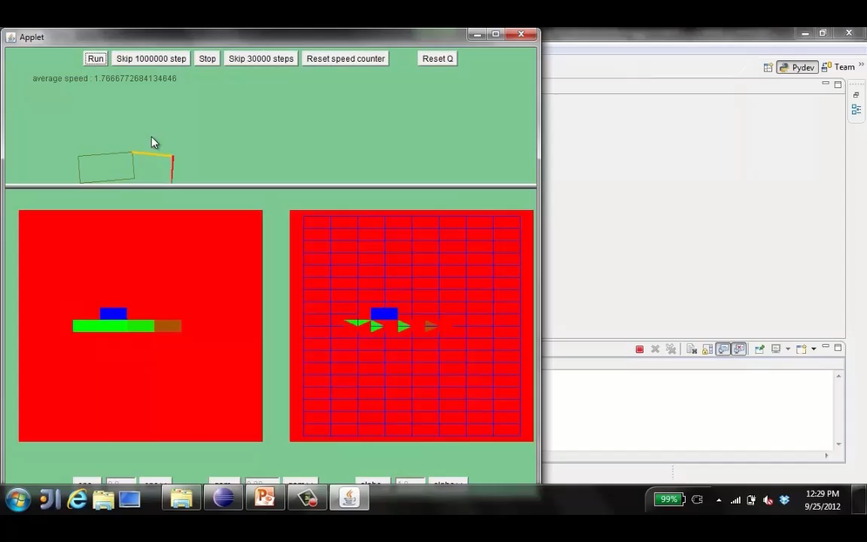
Video 2 of Q-Learning demo -- Crawler
Credit: CS188 – Intro to AI, UC Berkeley, ai.berkely.edu

Slide 39
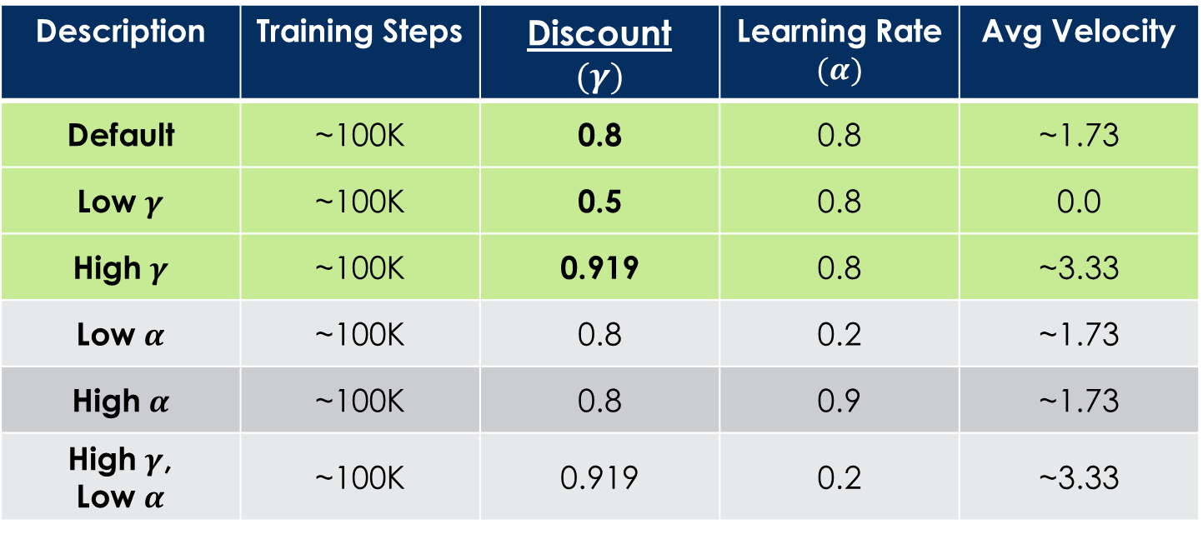
Q-Learning Example: discount effect
Update rule:
Description | Training Steps | Discount $$(γ)$$ | Learning Rate $$(α)$$ | Avg Velocity
Default | ~100K | 0.8 | 0.8 | ~1.73
Low $γ$ | ~100K | 0.5 | 0.8 | 0.0
High $γ$ | ~100K | 0.919 | 0.8 | ~3.33
Low $α$ | ~100K | 0.8 | 0.2 | ~1.73
High $α$ | ~100K | 0.8 | 0.9 | ~1.73
High $γ$, Low $α$ | ~100K | 0.919 | 0.2 | ~3.33

Slide 40

Q-Learning Properties
Amazing result: Q-learning converges to optimal policy -- even if you’re acting sub-optimally!
This is called off-policy learning
Caveats:
You have to explore enough
You have to eventually make the learning rate
small enough
… but not decrease it too quickly
Basically, in the limit, it doesn’t matter how you select actions (!)
Credit: CS188 – Intro to AI, UC Berkeley, ai.berkely.edu

Slide 41

Approximate Q-Learning
Credit: CS188 – Intro to AI, UC Berkeley, ai.berkely.edu

Slide 42


Generalizing Across States
Basic Q-Learning keeps a table of all q-values
In realistic situations, we cannot possibly learn about every single state!
Too many states to visit them all in training
Too many states to hold the q-tables in memory
Instead, we want to generalize:
Learn about some small number of training states from experience
Generalize that experience to new, similar situations

Slide 43
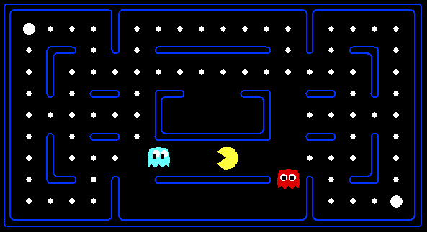



Example: Pacman
Let’s say we discover through experience that this state is bad:
In naïve q-learning, we know nothing about this state:
Or even this one!
Credit: CS188 – Intro to AI, UC Berkeley, ai.berkely.edu

Slide 44
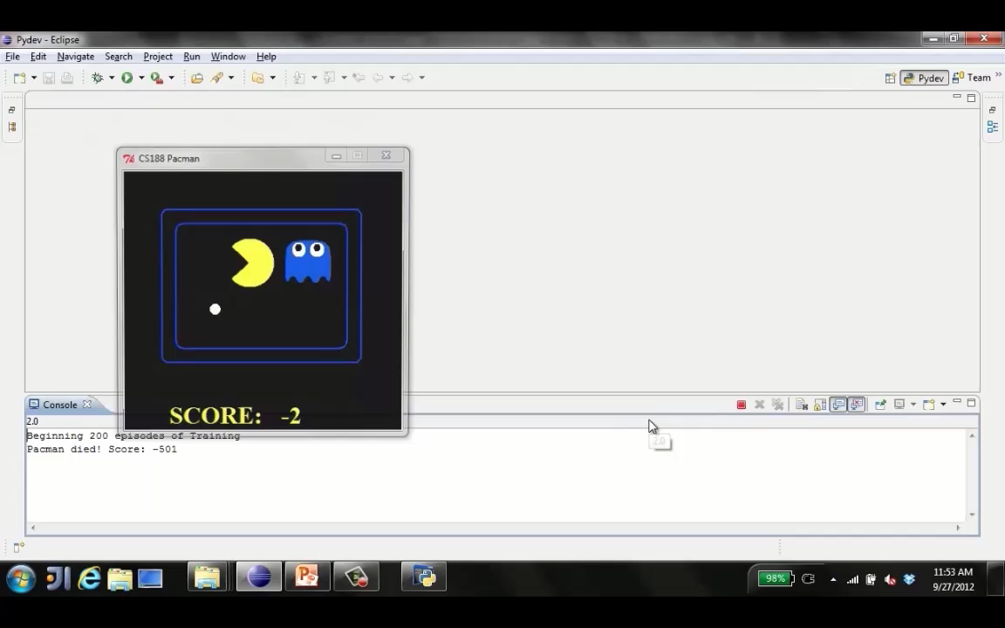
Tiny pacman demo 1
Credit: CS188 – Intro to AI, UC Berkeley, ai.berkely.edu

Slide 45
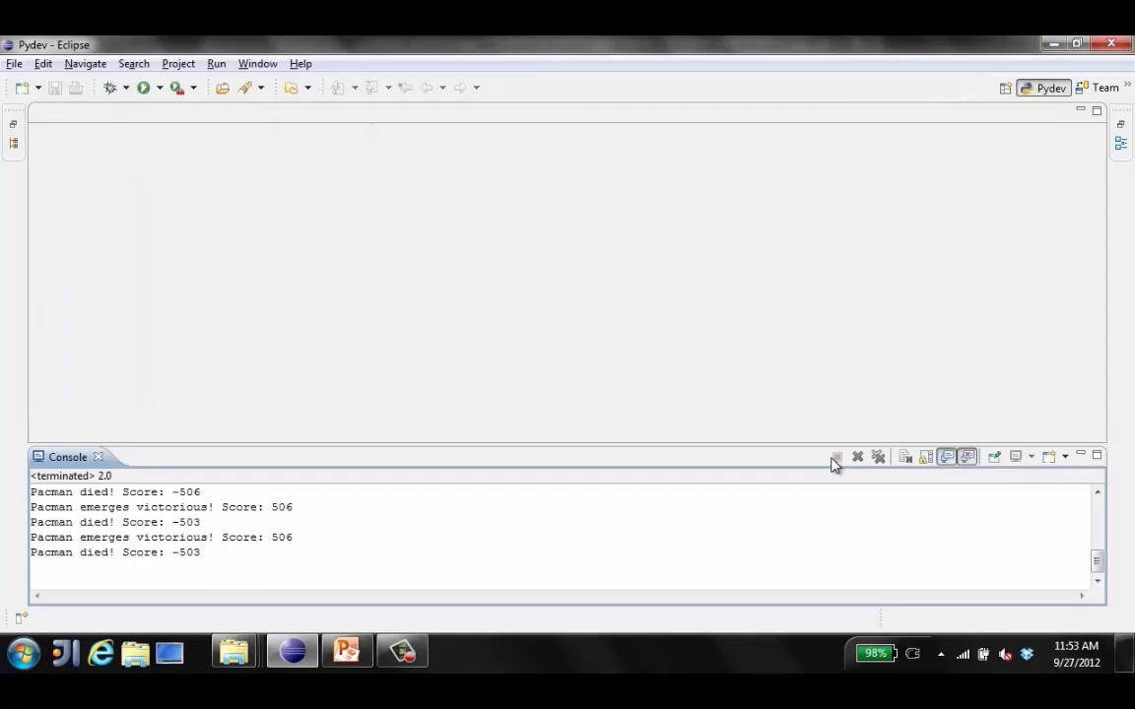
Tiny pacman demo 2
Credit: CS188 – Intro to AI, UC Berkeley, ai.berkely.edu

Slide 46
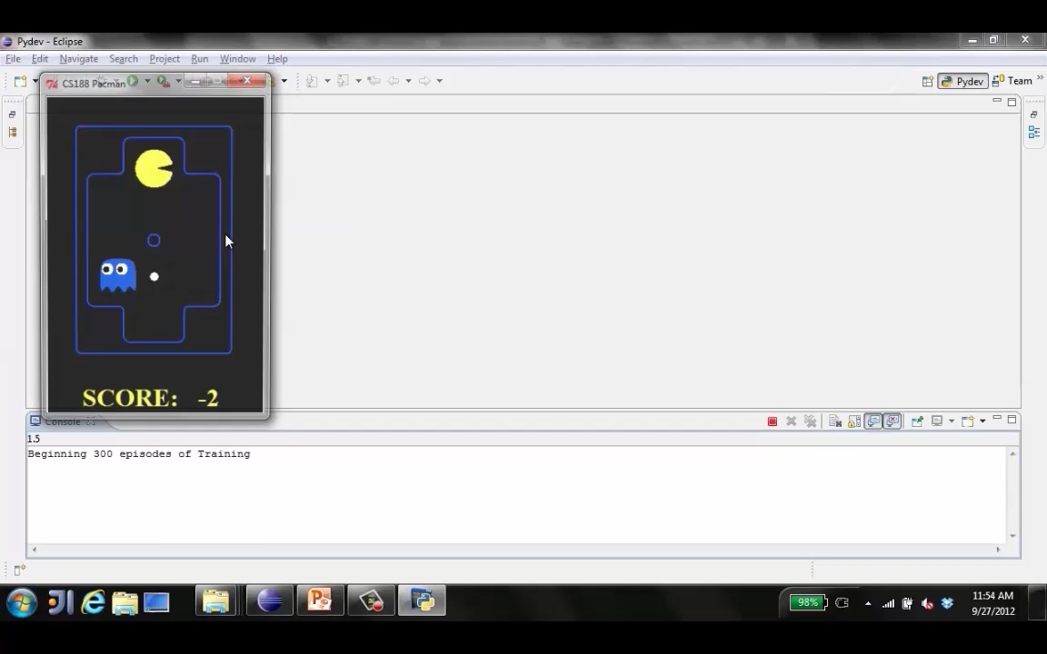
Tiny pacman demo 3
Credit: CS188 – Intro to AI, UC Berkeley, ai.berkely.edu

Slide 47


Feature-Based Representations
Solution: describe a state using a vector of features (properties)
Features are functions from states to real numbers (often 0/1) that capture important properties of the state
Example features:
Distance to closest ghost
Distance to closest dot
Number of ghosts
1 / (dist to dot)²
Is Pacman in a tunnel? (0/1)
…… etc.
Is it the exact state on this slide?
Can also describe a q-state (s, a) with features (e.g. action moves closer to food)
Credit: CS188 – Intro to AI, UC Berkeley, ai.berkely.edu

Slide 48
Linear Value Functions
Using a feature representation, we can write a q function (or value function) for any state using a few weights:
Advantage: our experience is summed up in a few powerful numbers
Disadvantage: states may share features but actually be very different in value!
Credit: CS188 – Intro to AI, UC Berkeley, ai.berkely.edu

Slide 49

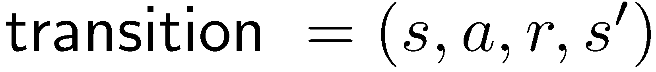
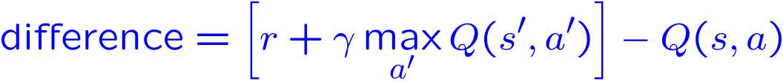
Approximate Q-Learning
Q-learning with linear Q-functions:
Intuitive interpretation:
Adjust weights of active features
E.g., if something unexpectedly bad happens, blame the features that were on i.e., “dis-prefer” all states with that state’s features
Formal justification: online least squares
Exact Q’s
Approximate Q’s
Credit: CS188 – Intro to AI, UC Berkeley, ai.berkely.edu

Slide 50

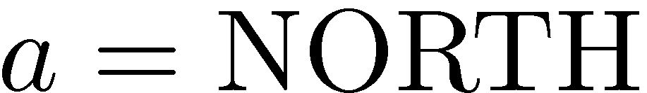
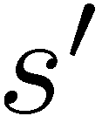

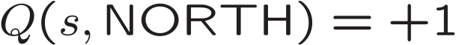
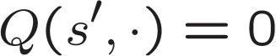
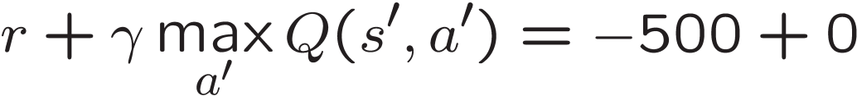
Example: Q-Pacman
Credit: CS188 – Intro to AI, UC Berkeley, ai.berkely.edu

Slide 51
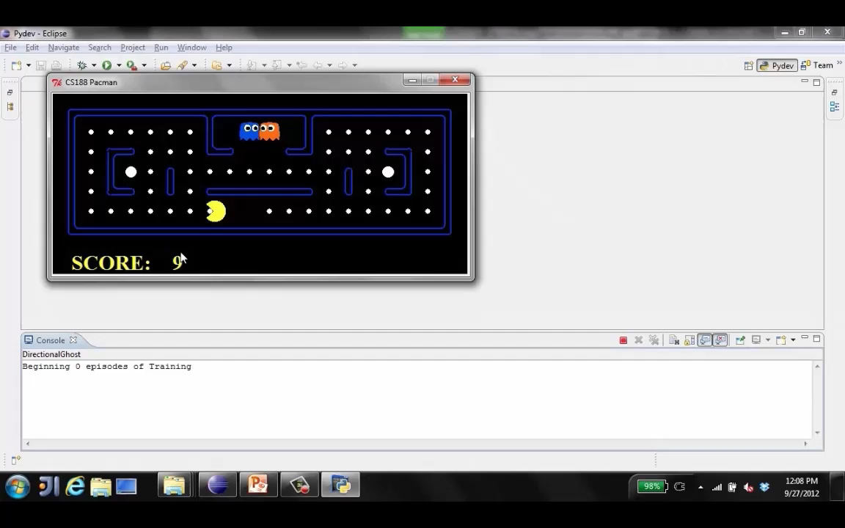
Approximate Q-Learning demo -- pacman
Credit: CS188 – Intro to AI, UC Berkeley, ai.berkely.edu

Slide 52
Next Time: More RL
Possible Topics:
Credit Assignment
Online Learning vs Offline learning
SARSA vs Q-Learning
Hybrid Approaches:
Temporal Difference (TD) Value Learning
Dyna-Q
Partially Observable Markov Decision Processes (POMDPs)
Deep Q-Learning

